Slide 1

Database Fundamentals & Foundation

Slide 2
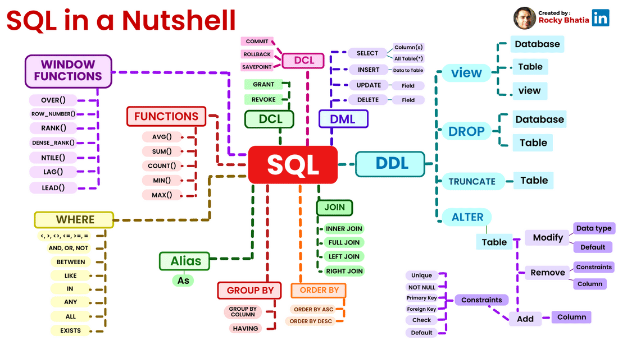
Memorandum of Understanding of SQL Learning
How much SQL learning is important
What and How much SQL we are going to learn in this session
Who are the Intended Learners
How to learn SQL smartly
How we can do practice

Slide 3

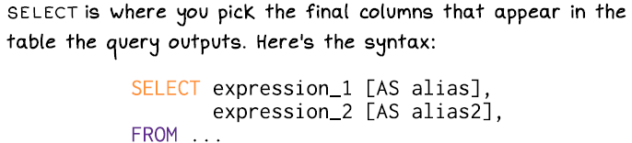
Few SQL Facts..
SQL was developed in the 1970s by IBM researchers Donald Chamberlin and Raymond Boyce. The language was originally called "SEQUEL."

Slide 4

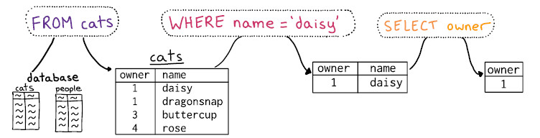
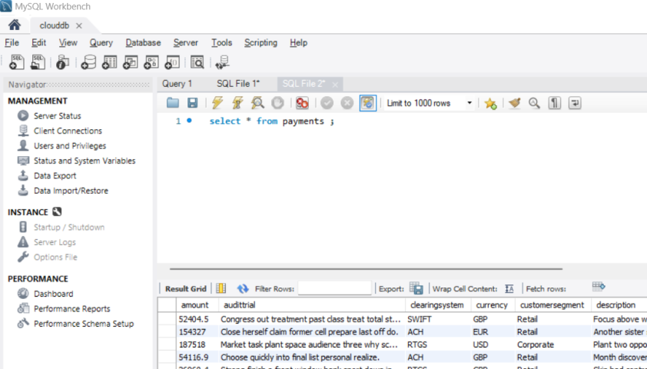

RDBMS Architecture

Slide 5
RDBMS Architecture

Slide 6
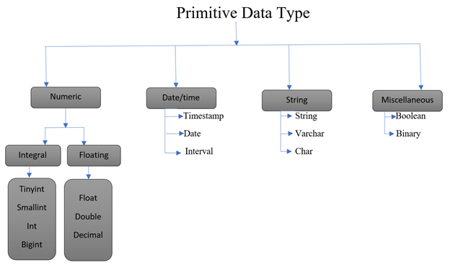
Components of DB
Database – is the container of all related objects (tables, views, indexes etc.,)
Schema – Schema is Database, We can interchangeably use the term Schema to denote Database or Catalog (schema/catalog is a an alias of database)
Database = Schema = Catalog = dataset
Tables – Table is container of data in a form of rows and columns with some structure defined.
Field or Column – an name/attribute contains the part of table data identified vertically
Data Type – The property defined for a given column based on the type of values stored – eg. short , Int, long, decimal(10,2), float, double, char, varchar, date, timestamp
Record or Row –collection of column values , identified horizontally with some identifier
Views – View is a stored query
Procedures/Functions -
Indexes
create database izlearning;
use izlearning;
create table sample1(id bigint,name varchar(100),age smallint);
drop table abcde;
create table abcde(a int default 0,b char(1));
show tables;
insert into sample1 values(1,'irfan',42);
insert into sample1 values(null,'inceptez',10);
select * from abcde;
insert into abcde(b) values('y');
describe abcde;

Slide 7
SQL Query Types – Let’s learn it easily
DDL-Data Definition Language (Priority 2)
DML-Data Manipulation Language (Priority 2)
DCL-Data Control Language (Priority 3)
TCL-Transaction Control Language (Priority 3)
DQL-Data Query Language (Priority 1)

Slide 8
SQL Query Types – Let’s learn it easily
DDL-Data Definition Language (Priority 2)
Create, Alter, Drop
DML-Data Manipulation Language (Priority 2)
Insert, Update, Delete
DCL-Data Control Language (Priority 3)
Grant, Revoke
TCL-Transaction Control Language (Priority 3)
Commit, rollback, Start transaction
DQL-Data Query Language (Priority 1)
Select, filtering, operators, like, between, in, sorting, aggregation, builtin functions, case, joins, subqueries, CTEs, functions

Slide 9
DDL – Data Definition Language
Create, Drop database/schema
create schema aspirantsdb;
create database aspirantsdb;
Drop database irfandb;
create, modify the layout of a table
Use aspirantsdb;
Create table irfantbl(id int,name varchar(100),age int, dob date);
describe irfantbl;
Alter table irfantbl add city varchar(100);
describe irfantbl;
alter table irfantbl drop column age,drop column name;
describe irfantbl;
alter table irfantbl drop column dob;
alter table irfantbl rename to incepteztbl;
describe incepteztbl;
Load data to a table (DML)
Insert into irfantbl values(1,’irfan’,42,’1982-01-29’);
Create & load table from another table with/without data
/* CTAS with data, CTAS without data, IS query */
create table irfantbl_bkp as select * from irfantbl;
create table irfantbl_bkp_nodata as select * from irfantbl where 1=0;
(DML)
insert into irfantbl_bkp_nodata select * from irfantbl;
select * from irfantbl_bkp_nodata;
Constraints - Default Values & NULLS
create table abcde(a int default 0,b char(1));
Insert into abcde(b) values('x');
create table abcde(a int not null,b char(1));
Insert into abcde(b) values('y');
Truncate the table (delete the data from the table)
/*dml operation, we can do conditional delete (DML) */
delete from irfantbl_bkp_nodata where age<>42;
/*ddl operation, we can't do conditional truncate, truncate will remove only data not the structure of the table*/
truncate table irfantbl_bkp_nodata;
Drop/rename a table from the schema
/*ddl operation, we can't do conditional drop , drop will remove both data and the structure of the table*/drop table
drop table irfantbl;

Slide 10
DML
Insert
Single/multi row, few columns, from another table (IS)
create table sample2(id bigint,name varchar(100),age smallint);
insert into sample2 values(1,'irfan',42);
insert into sample2 values(2,'saravana',32),(3,'venkat',33);
insert into sample2(id,age) values(4,35),(5,33);
select * from sample2;
create table sample3(id bigint,age smallint);
insert into sample3 select id,age from sample2;
select * from sample3;
Update
Single/multi row, Single/multi columns, from another table
create table custinfowdwe (id int,name varchar(100),age int);
insert into custinfowdwe values(1,'irfan',42);
insert into custinfowdwe values(2,'dhamo',32);
insert into custinfowdwe values(3,'abcd',31);
update custinfowdwe set age=43 where id=1;
update custinfowdwe set name=upper(name),age=age+1 where age>30;
update custinfowdwe set age=(select max(id) from praveen) where id=1;
Delete
Single/multi row, Single/multi columns, from another table
delete from custinfowdwe where id=1;
delete from custinfowdwe where id=(select max(id) from praveen);

Slide 11
TCL – Will not supported in Bigdata, least priority
Commit
SET autocommit=0 or 1
Commit DML data
Rollback
Rollback DML data
Transaction Control
Start Transaction
drop table bms;
create table bms(id int, seats varchar(100), ts timestamp);
set autocommit=0;
start transaction;
insert into bms values(2,'b1,b2',current_timestamp);
select * from bms;
commit;
rollback;
select * from bms;

Slide 12
DCL
Grant
grant select on core_banking.tbl2 to inceptez;
Revoke
revoke select on core_banking.tbl2 from inceptez;

Slide 13
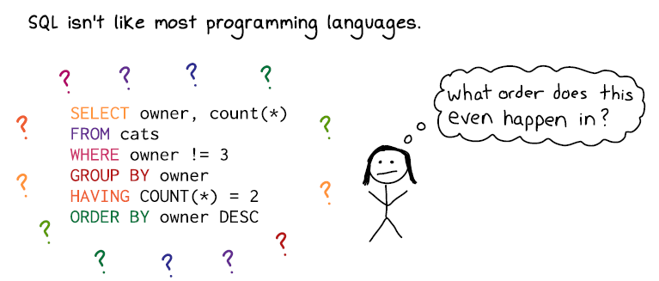
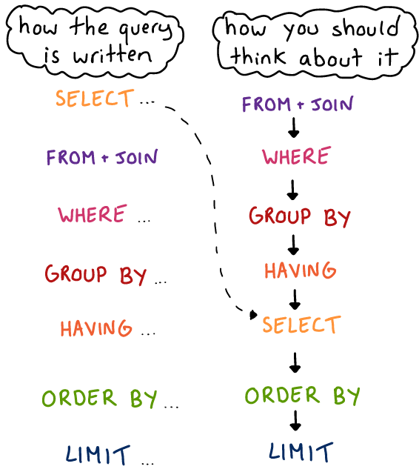
DQL (Important)
Select
Single/multiple columns, alias
Filter rows
Operators Types
Like, in, between operators
Distinct, Sorting
Aggregation
Built in functions
Case statements
Sub queries, CTEs, Views
Joins
Set Operators
Analytical & Windowing Functions

Slide 14
DQL (Important)
Select
Single/all/multiple columns, alias
select department_id as did,upper(department_name) dname from departments;
Filter rows
select department_id as did,upper(department_name) dname from departments Where department_id>30;
Operators Types (arithmetic, logical, comparision)
select employee_id,department_id,salary,salary + 1000 bonus_sal from employees where department_id = 60 or salary>4800;
Like, in, between and operators
select * from employees where first_name like '%ex%';
select * from employees where job_id in ('IT_PROG','PU_CLERK');
select * from employees where salary between 4800 and 9000;
Type Casting
select * from employees where cast(salary as char(100)) like '%8%';
Distinct, Sorting
select distinct job_id from employees;
select distinct department_id,job_id from employees order by department_id ASC,2 DESC;
Aggregation
select count(1) total_employees_in_my_company from employees;
select sum(salary) total_salary_of_employees_in_my_company from employees;
select avg(salary) avg_salary_of_employees_in_my_company from employees;
select min(salary) min_salary_of_employees_in_my_company,max(salary) max_salary_of_employees_in_my_company from employees;
/* Department wise min_max_salary_of_employees */
select department_id,min(salary) min_sal,max(salary) max_sal
from employees
group by department_id;
Built in functions
Case statements
Sub queries, CTEs, Views
Joins
Set Operators
Analytical & Windowing Functions

Slide 15
DQL (Important)
Select
Built in functions
/* STRING FUNCTIONS, NUMERICAL FUNCTIONS, DATE FUNCTIONS, AGGREGATION FUNCTIONS, CONVERSION FUNCTIONS, CASTING FUNCTIONS ETC., */
select substr(job_id,1,2) as first_2_chars, trim(job_id) space_removed_job_id, upper(concat(first_name,' ',last_name)) full_name,MOD(employee_id,2) employee_id_even_odd_number,abs(salary*-1) postive_salary,e.* from employees e;
COMPLETE SQL CLAUSES IN ONE QUERY!!!
/* Show me the top 1 the job_id wise average salary where average salary > 3000 on the department of IT and SHIPPING */
select job_id,avg(salary) avg_sal
from employees
where department_id in (50,60)
group by job_id
having avg(salary)>3000
order by 2 desc
limit 1;
select job_id,avg(salary) avg_sal
from employees e inner join departments d
on e.department_id=d.department_id
where d.department_name in ('SHIPPING','IT')
/*department_id in (50,60) */
group by job_id
having avg(salary)>3000
order by 2 desc
limit 1;
Case statements
Sub queries, CTEs, Views
Joins
Set Operators
Analytical & Windowing Functions

Slide 16
DQL (Important)
Select
Single/multiple columns, alias
Filter rows
Operators Types
Like, in, between operators
Distinct, Sorting
Aggregation
Built in functions
Case statements
Sub queries, CTEs, Views
Joins
Set Operators
Analytical & Windowing Functions

Slide 17

TYPES OF JOINS
Types of Joins | Description
Inner Join | Returns the Data from both tables that matches the join columns value
Outer Join | It returns also the rows that do not satisfy the join condition
Self Join | Joining data in a table to itself

Slide 18

EQUIJOIN
SELECT e.emp_name, e.emp_deptno, d.dept_name FROM emp e, dept d
WHERE e.emp_deptno = d.deptno ORDER BY emp_name;
EMP_NAME | EMP_DEPTNO
KING | 10
BLAKE | 30
CLARK | 10
DEPT_NO | DEPT_NAME
10 | ACCOUNTING
30 | SALES
20 | OPERATIONS
EMP_NAME | EMP_DEPTNO | DEPT_NAME
KING | 10 | ACCOUNTING
BLAKE | 30 | SALES
CLARK | 10 | ACCOUNTING

Slide 19
OUTERJOIN
SQL> SELECT e.emp_name, e.emp_deptno, d.dept_name FROM emp e left outer join dept d
on (e.emp_deptno = d.deptno )
ORDER BY emp_name;
EMP_NAME | EMP_DEPTNO
KING | 10
BLAKE | NULL
CLARK | 10
MARTIN | 20
TURNER | 10
JONES | NULL
DEPT_NO | DEPT_NAME
10 | ACCOUNTING
30 | SALES
20 | OPERATIONS
EMP_NAME | EMP_DEPTNO | DEPT_NAME
KING | 10 | ACCOUNTING
BLAKE | NULL | NULL
CLARK | 10 | ACCOUNTING
MARTIN | 20 | OPERATIONS
TURNER | 10 | ACCOUNTING
JONES | NULL | NULL

Slide 20
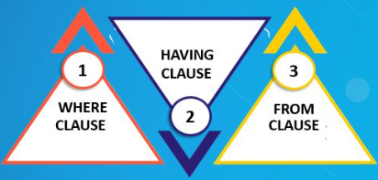
Sub Queries
Where Clause - Filter data based on results from another query.
Select Clause – Use subquery to calculate or retrieve values
From Clause – Subqueries as derived tables

Slide 21
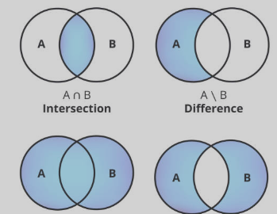
Set Operators
Combine multiple queries
Union without duplicates
SELECT name, email FROM employees UNION
SELECT name, email FROM visitors;
Union with the duplicates
SELECT cit_id FROM employees UNION ALL
SELECT cit_id FROM visitors;
Intersect
SELECT name FROM employees INTERSECT
SELECT name FROM visitors;
Minus
SELECT MINUS | name | FROM | employees
SELECT | name | FROM | visitors;

Slide 22
Top –N queries
We need to use “in-line view” together with the
pseudocolumn
What are the top 5 most well paid employees?
SELECT * FROM
(SELECT emp_id, last_name, salary
FROM employees
ORDER BY salary desc) WHERE rownum < 6
EMP_ID | LAST_NAME | SALARY
------ | ---------- | ------
100 | King | 24000
101 | Kochhar | 17000
102 | De Haan | 17000
145 | Russell | 14000
146 | Partners | 13500
What are the next 5 most well paid employees?
EMP_ID | LAST_NAME | SALARY
------ | ---------- | ------
108 | Greenberg | 12000
109 | Faviet | 9000
106 | Pataballa | 4800
105 | Austin | 4800
107 | Lorentz | 4200
SELECT emp_id, last_name, salary FROM ( SELECT emp_id,last_name, salary, rownum as rnum
FROM employees
ORDER BY salary desc) WHERE rnum between 6 and 10;

Slide 23
Window functions allow calculations across a "window" of rows related to the current row. They are specified using the OVER() clause. function_name([expression]) OVER ( [PARTITION BY column] [ORDER BY column [ASC|DESC]] )
Analytical Functions

Slide 24
MYSQL Cheat Sheet
Click This sheet ->

Slide 25
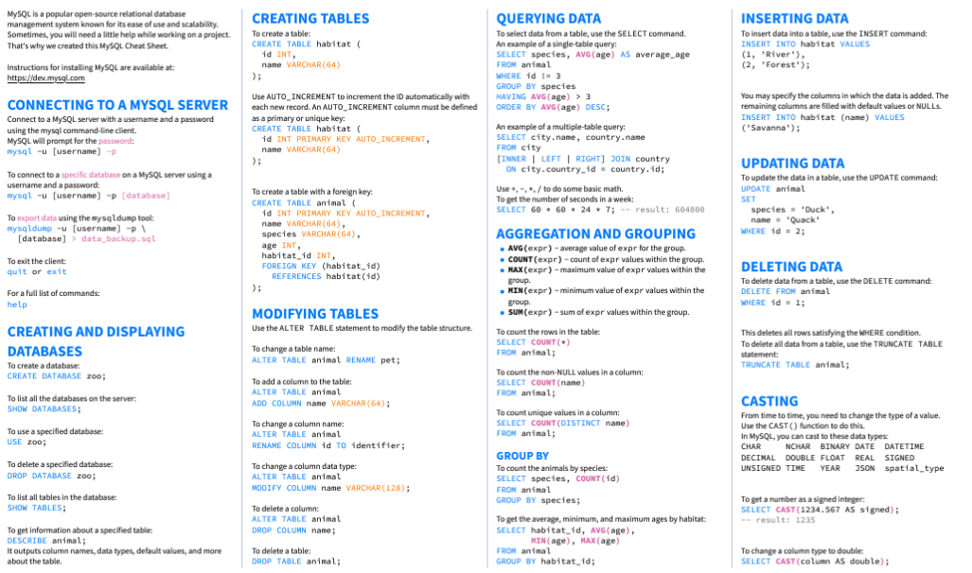
MYSQL Cheat Sheet

Slide 26
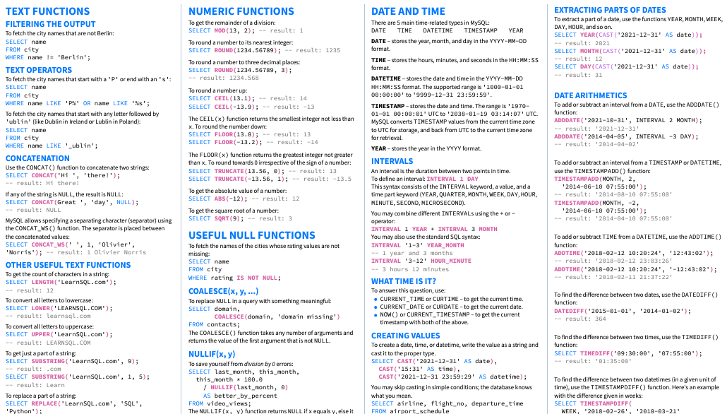
MYSQL Cheat Sheet

